Slide 1
Moving Forward with the Aeroelastic Prediction Workshop 3
Telecon Notes
Sept 9, 2019

Slide 2
Notes from Sept 12 2019 Telecon (Page 1/3)
Next telecon will be on Oct 10 (rather than on Oct 3 which is the first Thursday) in recognition of German Unity (or Unification?) Day
Webex: when the webex link comes up, there is an incorrect telecon number that is displayed.
Reviewed the survey. 9 parties had responded. Discussion of expanding the survey. Jens added more categories on the fly. Bret reminded us that he was taking the lead on the google poll which would maybe help us to identify what product(s) do each of us want to get out of a workshop? Whereas the existing (and complementary) poll is more focused on what physics do we care about. Should the poll be expanded or does the current one make it easy to observe trends and extract data?
Website landing page isn’t public-facing yet, and it only contains telecon information currently. Please try to access it again next week.

Slide 3
Notes from Sept 12, 2019, (page 2/3)
Steve Massey reviewed the experimental test cases that have been sent to him to date. (Steve’s slides are included in these slides)
High fidelity CFD workshop was mentioned and briefly discussed. We will ask Steve Wood, one of the organizers of that workshop, to discuss that workshop including planned test cases. Multi-purpose discussion: technical synergies, organizational aspects, possible participation
Based on initial survey feedback, formed 3 ad hoc exploratory working groups.

Slide 4
Notes from Sept 12, 2019 Telecon (Page 3/3)
Working groups- ad hoc exploratory phase groups?
  Large Deformation Working Group tentative membership (Carlos to coordinate initial email): Carlos Cesnik, Markus Ritter, Daniella Raveh, Jonathan Cooper, Earl Dowell, Kevin McHugh, Kai Bastos
  Hypersonics (Eric Blades to coordinate initial email): Eric Blades, Adam Jirasek, Kevin McHugh, Kai Bastos, Earl Dowell) Note that there may be interest from the High Fidelity CFD group.
  High angle of attack (Jen Heeg to coordinate initial email): Jen Heeg, and all those who have taken the survey except Markus (who is the only one who didn’t select this as an area of interest)
Expectations from these groups
  None?
  Item on the agenda of the next telecon to see if they have exceeded expectations
  Exchange emails or have discussions to try and find common ground, objectives, tests cases, other good things

Slide 5
Agenda, Sept 12, 2019
Review action items from August telecon
Experimental data review status
Survey progress & determining path forward
High Fidelity CFD workshop
Website progress

Slide 6
Action items, August telecon
All: send inputs to Steve Massey on experimental data sets(steven.j.massey@nasa.gov)
All: take survey from Jens https://doodle.com/poll/gbxvw3u4ispqetz5
All: contemplate format of workshop
Jen: post to collaborative “website”
Steve: collect inputs on experimental data sets, contemplate.
Jen: send out slides
Jen: have IFASD notes put into distributable form
Jen: new AePW-3 website initiated
Targeting AIAA Aviation 2020 as kickoff, or a technical interchange meeting? (Reno, Nevada)

Slide 7
Experimental data review slides from Steve Massey
(next 6 slides)

Slide 8
AePW-3 Topics Presented in Savannah, 2019
X-56 Aeroelastic Demonstrator Vehicle (Alex Chin)
An aeroelastically tailored, highly flexible wing for collaborative testing (Wolf Kreuger)
Time to Solution (Pawel Chwalowski)
Fluid-Structure Interactions in Hypersonics (Earl Dowell)
Experimental Benchmark of a Highly Flexible Wing (Daniella Raveh, Arik Drachinsky)
Nonlinear Damping (Vin Sharma)
USAFA Workshop Thoughts (Adam Jirasek)
NASA Benchmark Models (Jen Heeg)
AePW-1 Lessons Learned, presented at IFASD 2013 (Jen Heeg)

Slide 9
Recently Suggested AePW-3 Validation Cases
Experimental Aeroelastic Models Design…(Earl Dowell) Ref: Aerospace 2016, 3, 12; doi:10.3390/aerospace3020012
  Topics:
    Flutter, limit cycle oscillations and gust response of a high aspect ratio wing. The dominant nonlinearity is structural, but there is some evidence of an aerodynamic nonlinearity due to the large motions leading to stall and flow separation. So this represents an opportunity to exercise a viscous CFD model to address this latter issue.
    Wing like plate models where again the dominant nonlinearity is structural. This has been modeled with good correlation between theory and experiment. There are two nonlinearities for a cantilevered plate or beam, inertial and stiffness.
    Airfoil with control surface freeplay. There is also some interesting work reported by Lockheed Martin on this topic for the F-35 (AFDC 2009). This has been modeled by our group, by PC Chen at ZONA, and by folks at Lockheed Martin with some success.
    An all movable tail with freeplay at the root. Has been modeled by our group with reasonable success. By the way this is the configuration that when studies 50 years ago to the current design criteria in the MIL SPECS and FAA guidelines. The earlier experiment was done when nonlinear modeling was in its infancy and the results were interpreted (or misinterpreted) in terms of linear concepts.
    A free to roll aeroelastic wing model with flutter and LCO. This model has been analyzed for flutter, but not yet for LCO. One expects the dominant nonlinearity to be structural, similar to the nonlinearity in 2.
    An oscillating airfoil model at very high angles of attack well beyond stall where a Von Karman vortex street like "buffet" occurs. This is a very good test case for CFD models and we continue to study this computationally.

Slide 10
Recently Suggested AePW-3 Validation Cases
Aerostabil wing (Markus Ritter) Refs: 1, 2, 3.
  Tested in TWG Göttingen in 2003
  Model is a tapered, swept half wing in composite construction, an extensive dataset (including LCOs) is available.
  Numerical simulation requires coupling with the detailed FE-model since the airfoil of the wing changes its shape under aerodynamic loading (due to the spar in the wing).
  CAD model for grid generation, the FEM and experimental data are available for particular test points.
  See Markus’s slides for further details.

Slide 11
Recently Suggested AePW-3 Validation Cases
High Aspect Ratio Wing (Jonathan Cooper)
  IFASD June 2019
  Tested in 2018
  Highly flexible wing.
  The data is low speed ( <= 50 m/s)
  Large amount of data (aerodynamics, structural, balance, displacements, strains, etc. measured simultaneously.
  There are various subsets that could be used.

Slide 12
Recently Suggested AePW-3 Validation Cases
NACA0012 wing in laminar incompressible flow (Adam Jirasek)
  Results not yet published.
  United States Air Force Academy low speed wind tunnel test of a NACA0012 wing.
  The airfoil oscillates somewhere between -10 and 30 degrees or -60 to 60 degrees--very sensitive to flow conditions.
  More details can be provided by Dr. Jurgen Seidel

Slide 13
Recently Suggested AePW-3 Validation Cases
MAVRIC Flutter Model Tranonsic Limit Cycle Oscillation Test (Suggested by Bret Stanford)
  Ref: AIAA-2001-1291
  Semi-span business jet wing-fuselage flutter model
  Tested at NASA Langley's Transonic Dynamics Tunnel with the goal of obtaining experimental data suitable for Computational Aeroelasticity code validation at transonic separation onset conditions.
  Unsteady pressures and wing responses were obtained for three wingtip configurations: clean, tipstore, and winglet.
  Traditional flutter boundaries were measured over the range of M = 0.6 to 0.9 and maps of Limit Cycle Oscillation (LCO) behavior were made in the range of M = 0.85 to 0.95.
  Effects of dynamic pressure and angle-of-attack were measured.
  Testing in both R134a heavy gas and air provided unique data on Reynolds number, transition effects, and the effect of speed of sound on LCO behavior.
  The data set provides excellent code validation test cases for the important class of flow conditions involving shock-induced transonic flow separation onset at low wing angles, including Limit Cycle Oscillation behavior.

Slide 14
Survey progress & path forward
https://doodle.com/poll/gbxvw3u4ispqetz5
Suggest defining a suite of cases as shown for the high fidelity CFD workshop
Possible collaboration and participation in high fidelity CFD workshop

Slide 15
Slides received from Kevin Jacobson.
Suggest that we ask a representative
from this workshop planning group to come to the October telecon and discuss their plans.
https://turbmodels.larc.nasa.gov/highfidelitycfd_workshop2021.html

Slide 16
High Fidelity CFD workshop

Slide 17
Website progress
https://nescacademy-s.larc.nasa.gov/workshops/AePW3/public/

Slide 18
Prior Telecons

Slide 19
Agenda, August telecon
Try and sort out dial in and telecon issues.
Survey of collaboration topics
Collaboration format
  Workshop and workshop process?
  Collaborative workspace that can naturally leads to a workshop?
Survey of unsteady aerodynamic experimental data sets
Next telecon Sept 5, 2019

Slide 20
Survey discussion
Jens’ initial draft of survey
https://doodle.com/poll/gbxvw3u4ispqetz5
Etherpad to collect ideas:
https://etherpad.net/p/AePW-3_survey
Bret’s survey format:
https://docs.google.com/forms/d/e/1FAIpQLSdU3a7cLwthdMQ_nDQ-a5ikGTB-rbqGFKQAuvgYy6-XPhsz-g/viewform?usp=sf_link

Slide 21
Collaboration format
Objective of workshops: Collaborate in an effective manner, getting the most return for time investment.
Prior workshops were patterned after Drag Prediction Workshop. This is not a requirement, but rather has been a choice. We are free to make a different choice.
Workshop and workshop process?
Collaborative workspace that can naturally leads to a workshop?

Slide 22
Objectives of the Aeroelastic Prediction Workshop
Assess the goodness of computational tools for predicting aeroelastic response, including flutter
Understand why our tools don’t always produce successful predictions
  Which aspects of the physics are we falling short of predicting correctly?
  What about our methods causes us to fall short of successful predictions?
Establish uncertainty bounds for computational results
Establish best practices for using tools
Explicitly illustrate the specific needs for validation experimentation- i.e. why what we have isn’t good enough
Establish community for leveraging experiences and processes

Slide 23
Survey of unsteady aerodynamic experimental data sets
Send technical reference papers on data sets acquired since 2005
Unsteady aerodynamics
Flutter
Buffet
LCO
Send to steven.j.massey@nasa.gov

Slide 24
Moving Forward with the Aeroelastic Prediction Workshop 3
Telecon Notes
July 11, 2019

Slide 25
July 11 telecon summary
There were considerable issues with the webex and with the telecon number. The telecon is separate from the webex, each with their own passcode. Many people had to try multiple times in order for the sign ins to function.
The need for a survey of interests for collaboration was discussed. Jens Nietsche (DLR) and Bret Stanford (NASA) each had survey formats that they were going to investigate and pass along to the group.
Additional clarifications from some of the proposed collaborative topics were provided by several of the topic proposers.
Next telecon was set for Thursday August 1 at 11 a.m.

Slide 26
Summary of IFASD discussion
The interests of the community are diverse
  Highly flexible, low-cost design and testing
    DLR, Technion, Liverpool
  Hypersonics
  Simple configurations with complex flow
  Transport category configuration (flexible common research model (CRM) similar to Drag Prediction Workshop configuration)
  Using flight test data for basis of prediction comparisons
    Fighter configuration (F-16)
    UAV platform (X-56)
There are many possible workshop approaches and formats for collaboration
How can we best leverage the common interests of the community to advance our discipline?

Slide 27
Langley perspective regarding workshop
We would like to participate in-- but not lead-- a workshop that focuses on another one of the areas of interest to the community
If there is sufficient community interest, we would lead a workshop focused on simple geometry with complex flow as the basis for a time-to-solution challenge problem
Longer term vision: advocate and align resources to design and fabricate complex geometry high-fidelity wind tunnel model
Workshop in a 2-year time frame???

Slide 28
Please keep trying the audio…
Phone number to dial in: 844-467-4685
Passcode: 7621229297

Slide 29
AePW 3 Discussion at IFASD 2019
June 2019
Savannah, GA

Slide 30
IFASD AePW-3 Discussion agenda
Overview
Introductions
1 slide on each topic
Discussion of other topics for consideration
10-15 minute presentations on each topic
Wrap up (11:45)
Side conversations & general chaos
Sign in sheet in the back of this room

Slide 31
Objectives of the Aeroelastic Prediction Workshop
Assess the goodness of computational tools for predicting aeroelastic response, including flutter
Understand why our tools don’t always produce successful predictions
  Which aspects of the physics are we falling short of predicting correctly?
  What about our methods causes us to fall short of successful predictions?
Establish uncertainty bounds for computational results
Establish best practices for using tools
Explicitly illustrate the specific needs for validation experimentation- i.e. why what we have isn’t good enough
Establish community for leveraging experiences and processes

Slide 32
Objectives for this meeting
Open discussion of potential workshop focus
Garner community interest and energy around topics
Begin a plan for forward path

Slide 33
Topics and Presenters
X-56 Aeroelastic Demonstrator Vehicle (Alex Chin)
An aeroelastically tailored, highly flexible wing for collaborative testing (Wolf Kreuger)
Time to Solution (Pawel Chwalowski)
Fluid-Structure Interactions in Hypersonics (Earl Dowell)
Experimental Benchmark of a Highly Flexible Wing (Daniella Raveh, Arik Drachinsky)
Nonlinear Damping (Vin Sharma)
USAFA Workshop Thoughts (Adam Jirasek)
NASA Benchmark Models (Jen Heeg)
AePW-1 Lessons Learned, presented at IFASD 2013 (Jen Heeg)

Slide 34
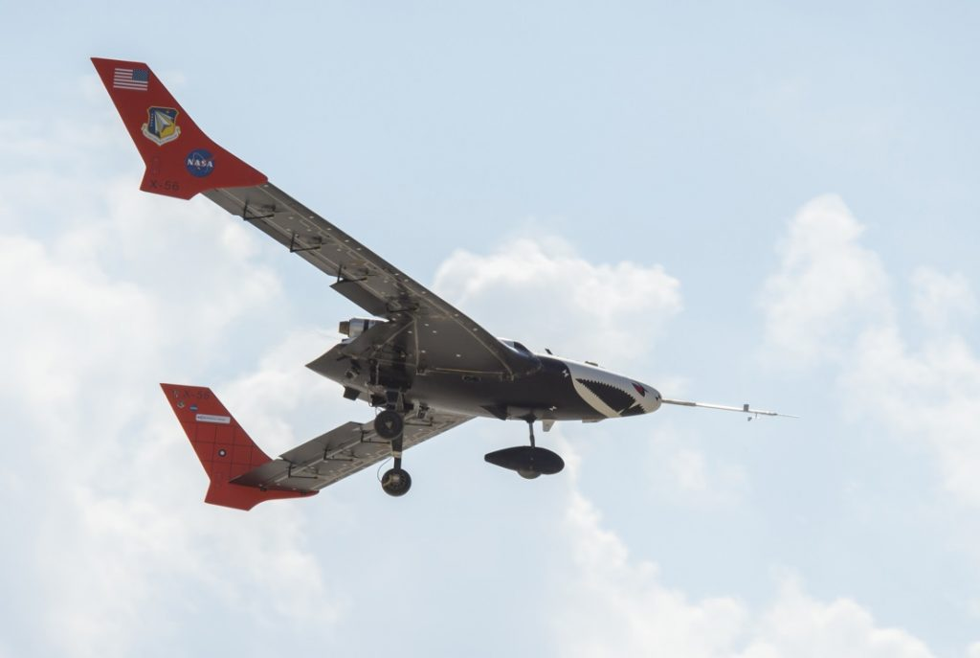
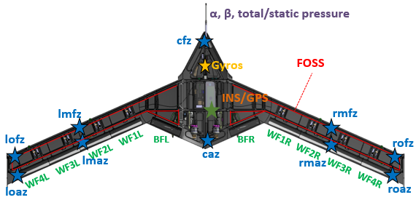
X-56 Aeroelastic Demonstrator
Alex Chin
NASA Armstrong Flight Research Center
alexander.w.chin@nasa.gov
Background
Deliverables
X-56A was developed under an AFRL program to explore actively controlling flutter
NASA’s Advanced Air Transport Technology Program
  Use subscale aircraft (X-56) to conduct research into using the control system to provide margin from flutter rather than adding more structure.
  Modeling, sensors, control, certifiability, etc.
  Reduce flutter margin requirements
Currently proposed as an ITAR restricted subgroup activity (Working release process for wider audience, but no guarantee)
GVT validated finite element model
CFD Gridding (Pointwise), some updates needed
Flight relevant environment data
  Defined Input / Measured Output via preprogrammed flight test aids
  “Open Loop” raps also performed to determine aeroelastic damping behavior
Modeling Challenges
Aeroelastic Prediction Workshop Proposal
Aerodynamic model:
  Some success in post-flight model tuning
  Still trying to understand accurate predictive modeling
    Panel method limitations in capturing all relevant physics?
    Aerodynamic damping in flexible vehicles?
  “Grand Challenge” for increasing confidence in predictive modeling complementary to controller robustness requirements. Many different modeling areas to study.
  Is this the right approach? What are we missing?
Leverage flight data measured from relevant environment as truth model for comparison studies to:
  Accurately predict flutter speed analytically
  Investigate formulating X-56 aeroelastic models for control
  Compare with flight derived models from X-56
Document modeling approaches

Slide 35
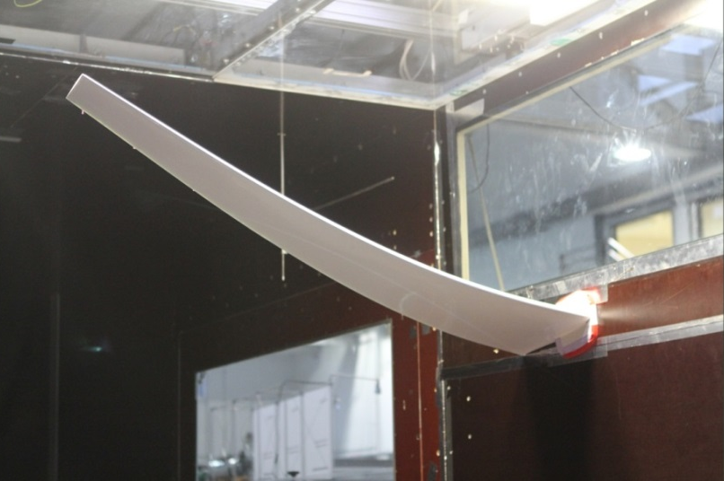
An aeroelastically tailored, highly flexible wing for collaborative testing
(Summary)
DLR idea for a common AePW-3 activity: Collaborative design and testing of a highly flexible, aeroelastically tailored wing
Goals:
Cost effective wing, reproducable, collaborative design and testing
Wing:
Span < 1.80 meters
High subsonic flow speed (isentropic flow) - 3D Panel, VLM, DLM, CFD
Fiber reinforced plastic design, Flaps actuated by electric RC-servos, Instrumentation depending on physical effects to be monitored
Several models with varying stiffness, tailoring, are easily build out of the mould
Aeroelastic effects to address?
Configuration complexity?
Flow field physics complexity?
Structural nonlinearities: Wing with high flexibility?
Aerodynamic nonlinearities?
Closed-loop system with gust generator?

Slide 36
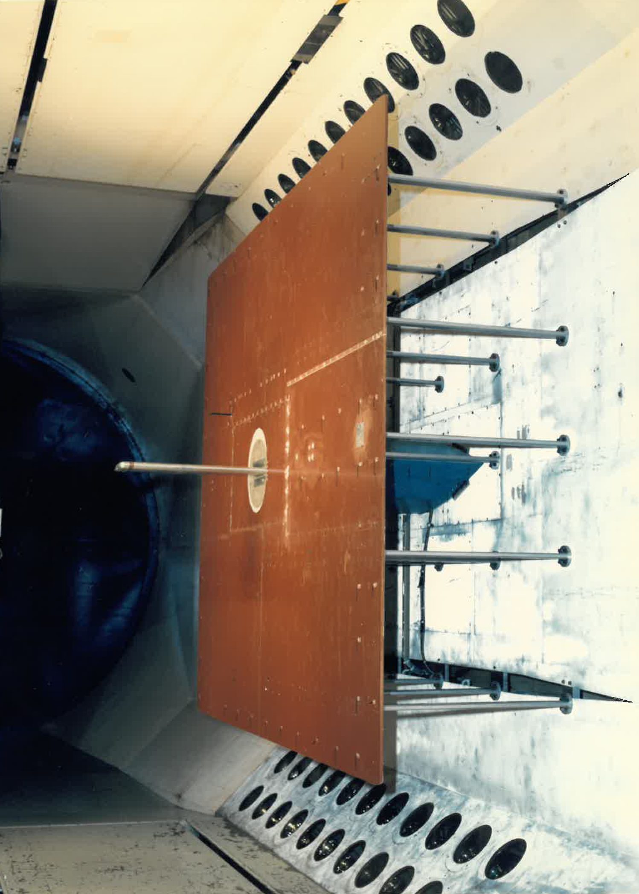
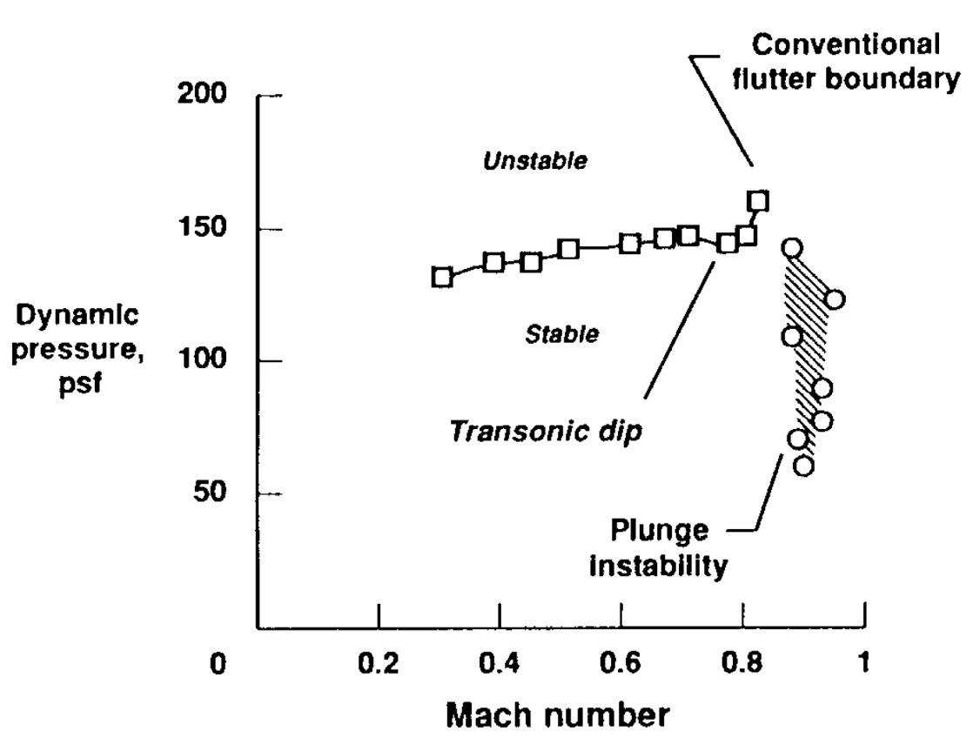
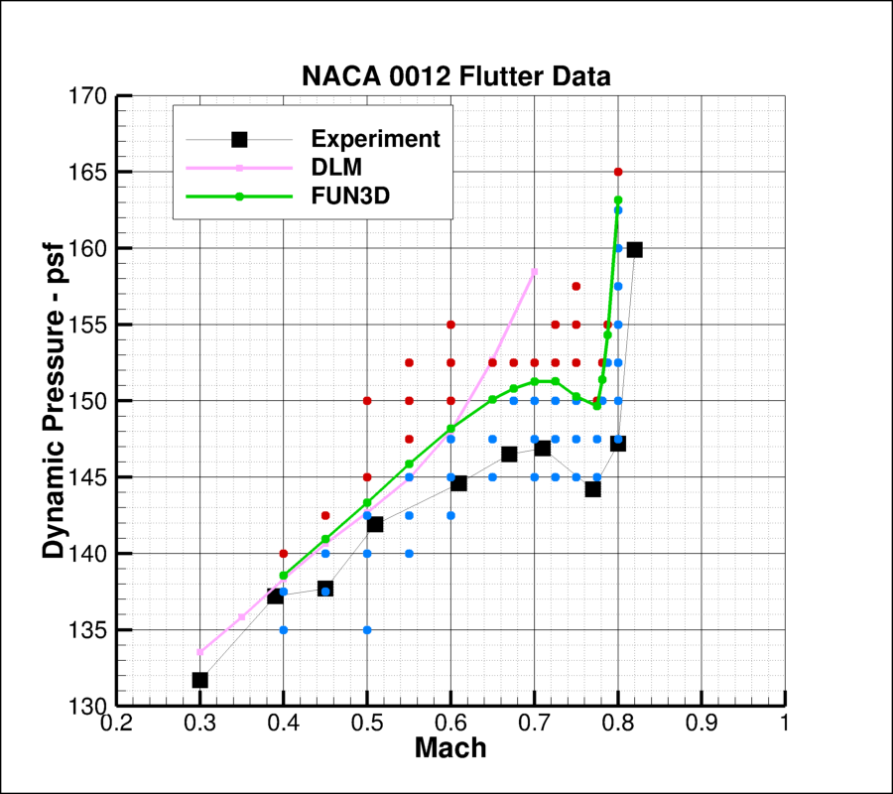
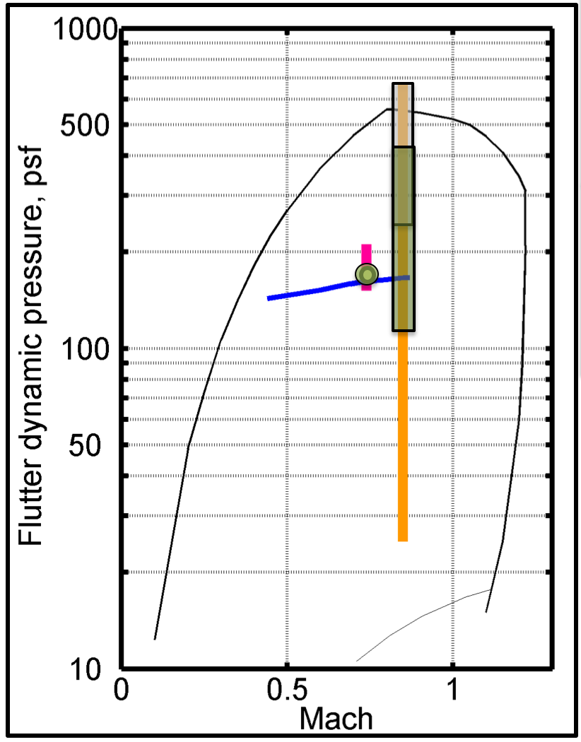
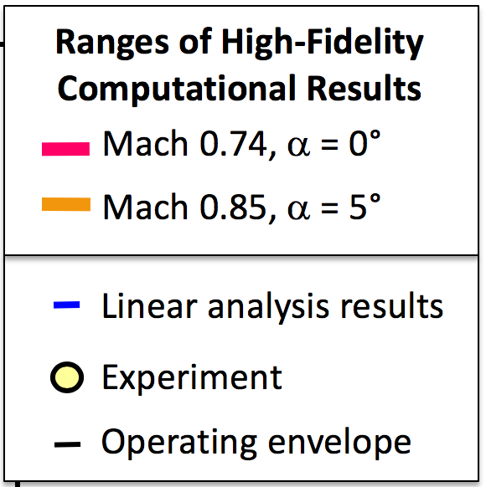
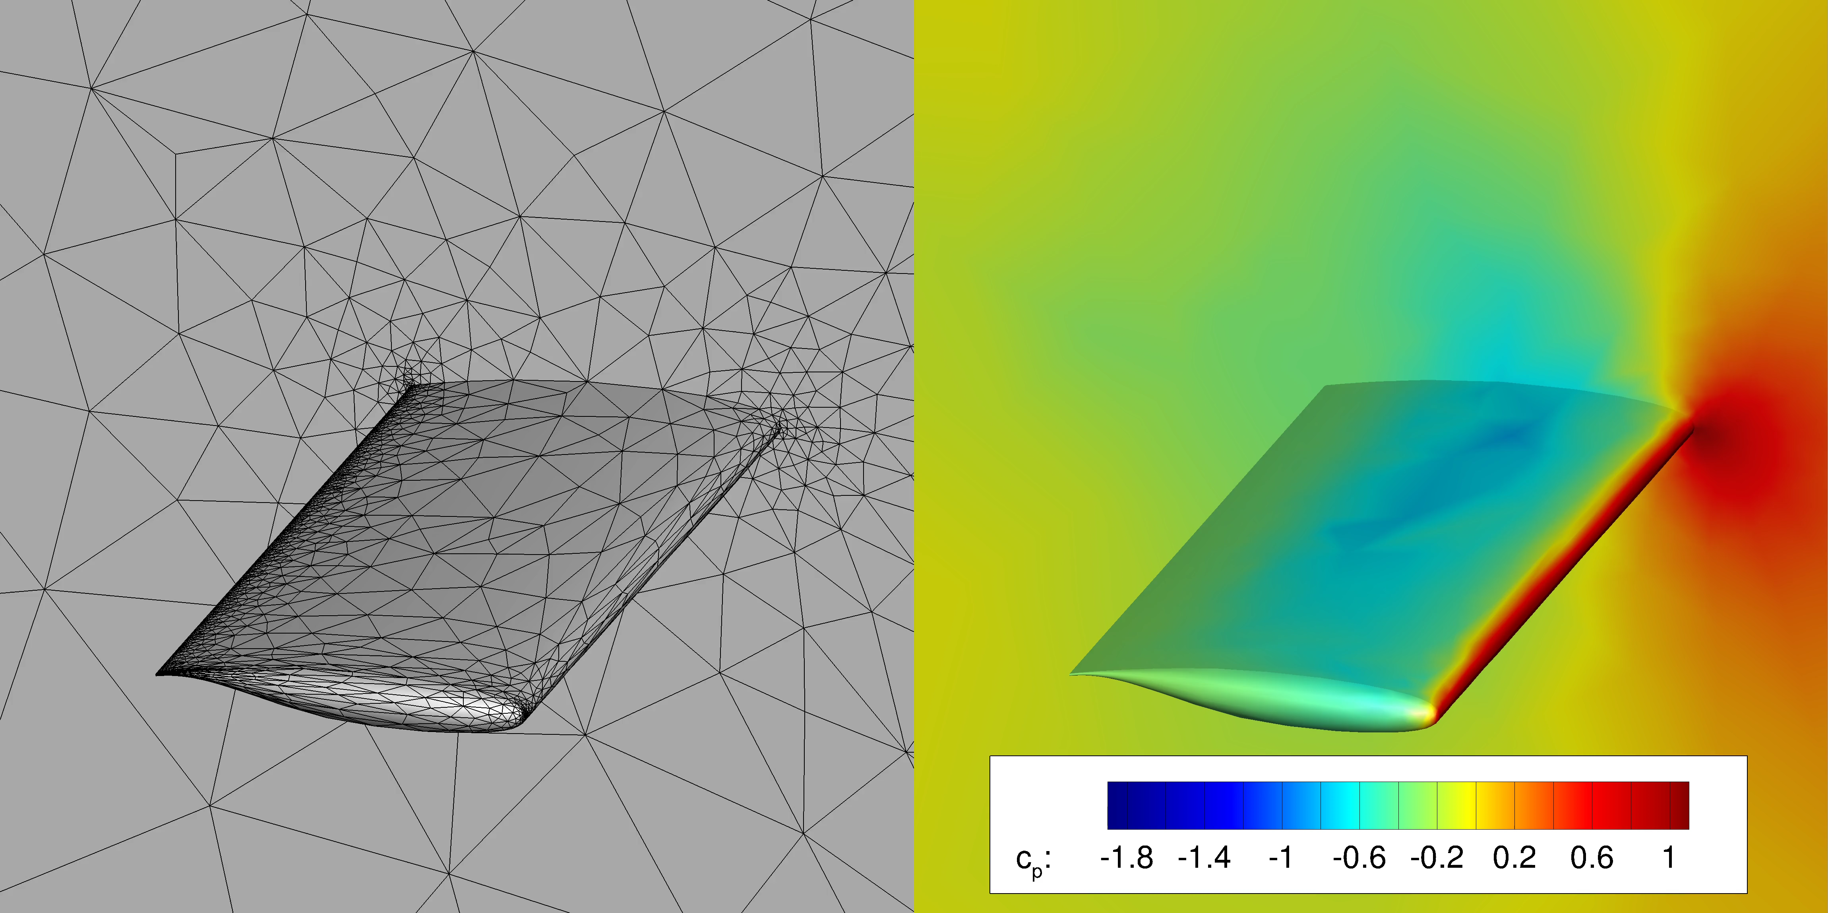
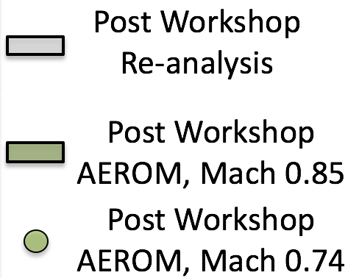
AePW-3 Discussion Session: Time-to-Solution Summary
NACA0012
State-of-the-art in CAE:
~18 weeks to compute
flutter boundary
Reduced Order Methods
are promising but require
further development
AePW-2 BSCW
Mesh Adaptation

Slide 37
HYPERSONIC FLUID STRUCTURE INTERACTION (FSI): WHY IS IT A TIMELY TOPIC FOR A FUTURE WORKSHOP?
Earl Dowell, Duke University
FIVE RECENT, CURRENT AND PLANNED WIND TUNNEL EXPERIMENTS
AFRL/AEDC (MIKE SPOTTSWOOD)/ BUCKLED PANEL IN A HYPERSONIC FLOW LEADS TO INCREASED AERODYNAMIC HEATING
SANDIA (KATYA CASPER)/ CURVED PANEL ON A CONE EXCITED BY TURBULENT BOUNDARY LAYER PRESSURES
MARYLAND/LANGLEY RESEARCH CENTER (STUART LAURENCE)/ ALL CLAMPED PANEL EXCITED BY SHOCK WAVE BOUNDARY LAYER INTERACTION
NORTH CAROLINA STATE (VENKAT NARAYANASWAMY)/ PLATES UNDER OSCILLATING SHOCK LOADS
UNIVERSITY OF NEW SOUTH WALES (ANDREW NEELY)/ FLUTTER AND LIMIT CYCLES OF CANTILEVERED (FLEXIBLE CONTROL SURFACE) AND CLAMPED (SKIN) PLATES
INDIVIDUALLY AND COLLECTIVELY THESE WIND TUNNEL EXPERIMENTS PROVIDE OPPORTUNITIES FOR USING COMPUTATIONAL MODELS TO DESIGN AND CORRELATE WITH EXPERIMENTS

Slide 38
An aeroelastically tailored, highly flexible wing for collaborative testing
(Summary)
DLR idea for a common AePW-3 activity: Collaborative design and testing of a highly flexible, aeroelastically tailored wing
Goals:
Cost effective wing, reproducable, collaborative design and testing
Wing:
Span < 1.80 meters
High subsonic flow speed (isentropic flow) - 3D Panel, VLM, DLM, CFD
Fiber reinforced plastic design, Flaps actuated by electric RC-servos, Instrumentation depending on physical effects to be monitored
Several models with varying stiffness, tailoring, are easily build out of the mould
Aeroelastic effects to address?
Configuration complexity?
Flow field physics complexity?
Structural nonlinearities: Wing with high flexibility?
Aerodynamic nonlinearities?
Closed-loop system with gust generator?

Slide 39
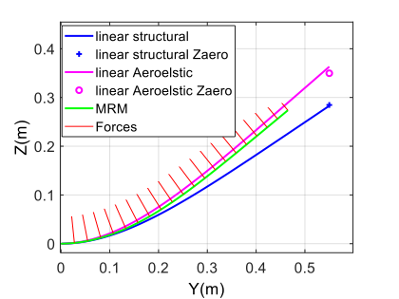
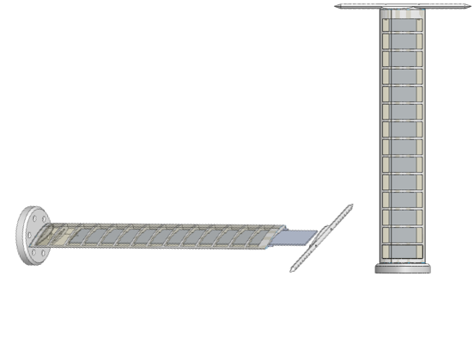
Experimental benchmark of a highly flexible wing
Goals:
  Generate a benchmark for static and dynamic (flutter) aeroelasticity of a very flexible wing. Will be used for validation of computational models and investigation of nonlinear aeroelastic phenomena.
  Gain experience with novel aeroelastic measurement techniques (optical fibers and a motion tracking camera system)
Model:
  Geometry:
    Chord - 100 mm, span - 550 mm
    Main spar: 550 X 60 X 2.5 mm, at the center-chord
    Airfoil - NACA0018
    Wing-tip rod for attaching weights
  Materials:
    Main spar - Aluminum 7075
    Chassis - Nylon, PA12, 3D-printed
    Cover - Foil (Oralight, or the like)
AePW benefits:
  Simple, low-cost design.
  Can be shared and tested in several wind-tunnels

Slide 40
F16 LCO & Nonlinear Damping;
Sharma, Reasor, Denegri
F-16 LCO: Aeroelastic instability that turns into LCO due to some nonlinearity in the system.
Successful simulations of LCO on several wing/store configurations using ZONA Euler Unsteady Solver (ZEUS) with synthesized nonlinear damping.
Is nonlinear damping in F-16 structure a fact or merely a figment of our imagination?
Conducted ground vibration tests on three wing configurations using step-sine technique on a cantilevered wing.
Processed data following the work of Carrella and Ewins with correction.
Found quantifiable nonlinear damping in each configuration tested.

Slide 41
USAFA Workshop Interests, (Adam Jirasek)
Test cases we currently work on
  NACA 0012 case
  BSCW case
Interested in having case with elastic geometry which needs non-modal coupling
Software development
  Fun3D
  Loci/CHEM

Slide 42
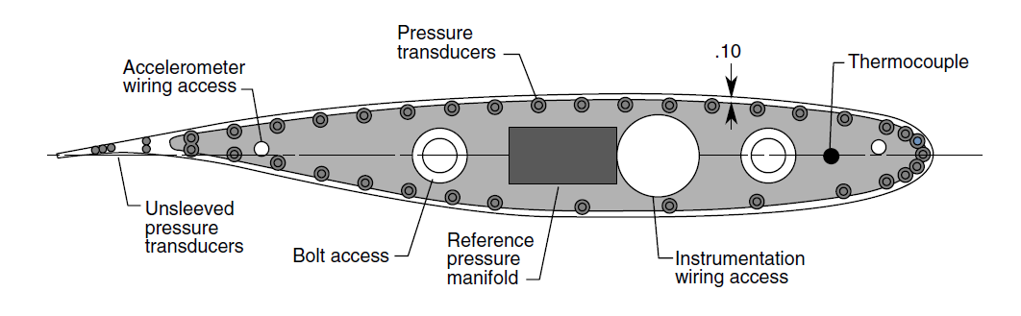
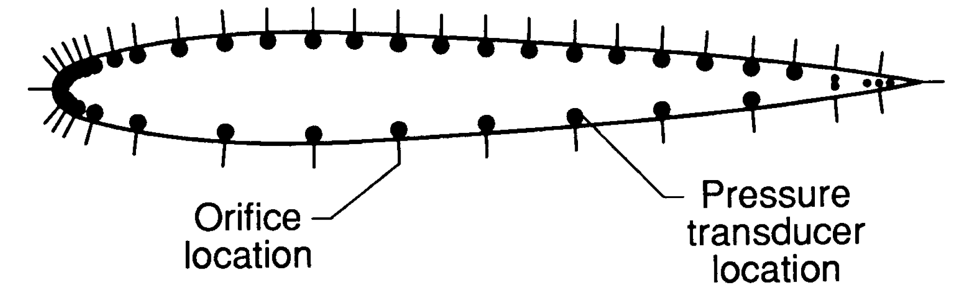
NASA Benchmark Models
3 models exist: NACA 0012, SC(2)-0414, 64A010
Data sets:
  Limited flutter boundaries, although some are very interesting flutter boundaries
  Frequency and Frequency response data at the flutter frequency
  Rigidized mount system steady data
  Some forced oscillation data
Planned retest: Supercritical wing

Slide 43
Things that we (I?) have learned
A workshop requires significant community energy
  Not just from 1 organization, but from at least a core group from 5-10 organizations
A well-posed problem leads to a better-posed workshop
  Focus the workshop as much as possible.
  Less confusion among participants, potential participants
Prepare for the onslaught of data right before the workshop
  It is recommended that participants have to format and test their own data in the comparison format
Organize early, organize often, always accept help

Slide 44
IFASD AePW-3 Discussion Follow Up
Slides saved to zip file and distributed.
Telecon follow up Thursday July 11, 3 pm UTC, (11 a.m. eastern time)
  US Dial-in #: 844-467-4685
  Japan Dial-in #: 0120 004 746
  Germany Dial-in #: 0 800 320 2291
  Israel Dial-in #: 1 80 921 2892
  UK Dial-in #: 0 800 358 8173 OR 0800 279 4867
  Local Toll Dial-in #: 1-720-259-7012
  ALL Passcode #: 7621229297
Follow up face-to-face meeting?
  Kickoff for AePW-3?
  At conference venues?

